Slide 1
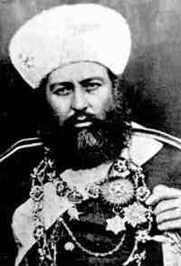
AMIR ABDUR RAHMAN (1844-1901 AD)
was Amir of Afghanistan from 1880 to 1901. He was the third son of Mohammad Afzal Khan, and grandson of Dost Muhmmad Khan.
Abdur Rahman Khan was considered a strong ruler who re-established the writ of the Afghan government after the disarray that followed the Second Anglo-Afghan War. He became known as The Iron Amir after defeating a number of rebellions by various tribes who were led by his relatives.

Slide 2
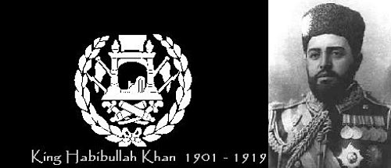
AMIR HABIBULLAH KHAN (1872-1919 AD)

Slide 3
AMIR HABIBULLAH KHAN (1901-1919 AD)
Amir Habibullah Khan from 1901-1919 was the king and ruler of Afghanistan.
(1872-1919) King Habibullah Khan, was born on June 3, 1872 and he was the eldest son of Amir Abdul Rahman Khan and the child of a slave mother and the father of King Amanullah Khan.
Habibullah Khan ruled Afghanistan from 1901, until his assassination in 1919 while he was on hunting trip to Laghman provice Afghanistan.
The King kept Afghanistan out of World War I. During his reign, Habibullah khan has modernized the country during his kingdom and built various roads and schools including the first modern school of Habibia which was built in 1904 in west part of Kabul Afghanistan and the military academy.
The flag of Afghanistan during his kingdom from 1901 until 1919, had a black background with an emblem in white color in the center.
The black background flag represented the black page of the history and the independence Afghanistan had not been achieved on that time.

Slide 4
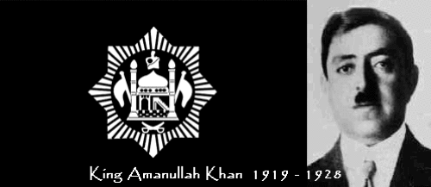
AMIR AMANULLAH KHAN (1890-1960 AD)

Slide 5
AMIR AMANULLAH KHAN (1919-1929 AD)
(1892-1960) Amir Amanullah Khan was born on June 1, 1892 and he was the third son of Amir Habibullah Khan. Shah Amanullah Khan rose to power after his father's assissanations on February 20th 1919 and he ruled the Emirate of Afghanistan from 1919 to 1929. Ghazi Amanullah Khan was the governor of Kabul as well as in control of the army and the treasury during the kingdom of his father. After the Third Anglo-Afghan War, Shah Amanullah Khan achieved the independence of Afghanistan over it's foreign affairs from the United Kingdom, although Afghanistan was never officially a part of the British Empire. The Firs-Anglo-Afghan-War in 1839–1842 followed with the Second-Anglo-Afghan-War in 1878–1880, and the Third-Anglo-Afghan-War in 1919 which led to the independence of Afghanistan. King Amanullah Khan announced Afghanistan's independence from foreign interventions at Eidgah Mosque in Kabul on August 19 1919. The King's services and reforms have been recorded in the history of Afghanistan which includes building of schools, power or electricity stations and much more. He had also developed a close diplomatic relationship with Europe and the rest of the world. In early 1929, Amanullah Khan abdicated and went into temporary exile in British India and his brother Inayatullah Khan became the king of Afghanistan for a few days until Habibullah Kalakani took over.

Slide 6
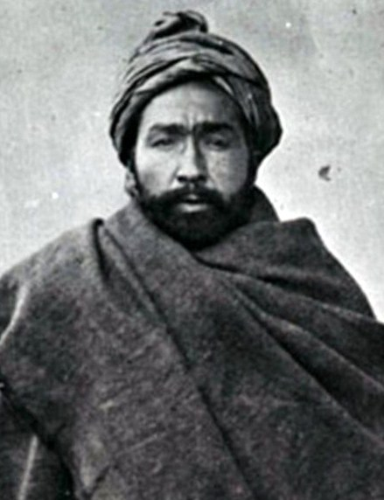
HABIBULLAH KALAKANI (1891-1929 AD)
was King of Afghanistan from January to October 1929 after deposing Amanullah Khan with the help of various Afghan tribes who opposed the modernization of Afghanistan. After gaining power in Kabul, he named himself Habībullāh Khādem-e Dīn-e Rasūlallāh ("The servant of the religion of the messenger of God"). He was himself defeated and overthrown nine months later by Mohemmad Nadir Khan.

Slide 7
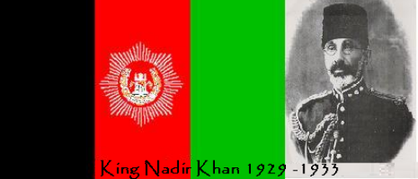
PRINCE MOHAMMED NADIR KHAN (1883-1933 AD)

Slide 8
PRINCE MOHAMMED NADIR KHAN (1929-1933 AD)
(1883-1933) King Nadir Khan was born in Dehra Dun in India on April 10, 1883 into Mohammadzay clan.
Nadir Khan was the king of Afghanistan After Amir Amanullah Khan from October 15, 1929 until his assassination in 1933. Nadir Khan was a military general in Amanullah Khan's monarchy. When the Anglo-Afghan war started in 1919, Nadir Khan volunteered to lead the national army to the south and to fight the enemy. After the kingdom of Amanullah Khan and during the 9 months leadership of Kalakani, Nadir fought for months until he had captured most part of the country from the leadership of Habibullah Kalakani's with the support of British Empire. Then he had killed Kalakani and himself became the Shah or king of Afghanistan.
On November 1933 while he was distributing awards to the high school graduates at Bala-e-sar Kabul, the King was shot dead by a teenager named Abdul Khaliq Hazara. Mohammad Nader Shah was criticized by many Afghan historians as an agent of Britain in Afghanistan. During his regime hundred of thousands of innocent civillians were killed in Afghanistan. During his Afghan kingdom, Afghanistan flag remained the same except has changed the emblem.

Slide 9
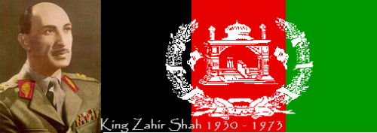
KING MOHAMMED ZAHIR KHAN (1914-2007 AD)

Slide 10
KING MOHAMMED ZAHIR KHAN (1930-1973 AD)
(1914-2007) King Zahir khan was born on 15 October 1914 in Kabul, Afghanistan. After the assassination of his father, Zahir Shah the 19- year old son of Nadir Shah become the long lasting King of Afghanistan for 40 years until he was ousted by a bloodless coup in 1973. Zahir Shah studied especial classes for princes at Habibia high school located in western part of Kabul and then he continued his education in France, where his father had been sent as a diplomatic envoy.
During the king’s time Kabul University was established in early 1930s, - 1940s and gradually the city began to grow as an industrial center and in the 1960s, Kabul city was largely developed. While Zahir Khan was in Italy for propose of eye surgery, his cousin and the Prime Minister Daud Khan staged a coup. Zahir Shah lived in exile in Italy for twenty nine years and after his return to the country in 2002, he was given the title of Father of the Nation by Afghan officials. Mohammad Zahir Khan, has died on July 23rd 2007 in Kabul Afghanistan. The flag of Afghanistan during King Zahir Shah was the same three strip color except the sun was removed from the emblem.

Slide 11
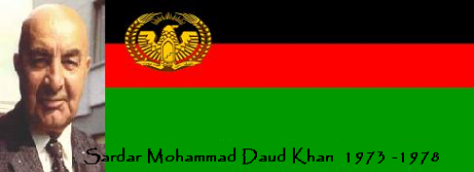
MOHAMMAD DAUD KHAN (1909-1978 AD)

Slide 12
MOHAMMAD DAUD KHAN (1973-1978 AD)
(1909 – 1978) Mohammad Daoud Khan which was known as Sardar Daud Khan was born on July 18, 1909 in Kabul Afghanistan in a royal family. Daoud Khan was a prince and politician of Afghanistan who overthrew the monarchy of his first cousin and brother-in-law Zahir Shah and became the first Afghanistan president from July 1973 until his assassination PDPA party in 1978. Before he become the president, Mohammad Daud Khan had served as a Prime Minister for ten years from 1953 until 1963. In 1973 Daoud Khan staged a bloodless coup and got the power from his cousin and (Brother-in-Law) Zahir Shah. Daoud Khan became the first president of Afghanistan and established a republican government for the first time and he never announced himself as a king (shah). Daud Khan was known for his progressive policies, especially in relation to the women rights.
On April 27, 1978, Daud Khan and most of his family were shot in the presidential palace and dumped in mass graves by the communist regime of Noor Mohammad Taraki, Hafizullah Amin and Babrak Karaml. However on June 2008, the body of the President Daud Khan and his family were found in two separate mass graves in the Pul-i-Charkhi district of Kabul.
The flag during Daud Khan's presidency was changed from vertical to horizontal style and embedded an eagle with two wheat branches as an emblem on top right side of the Afghan flag.

Slide 13
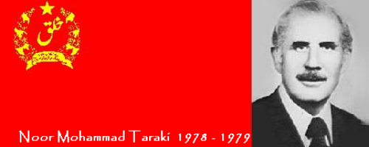
NOOR MOHAMMAD TARAKI (1913-1979 AD)

Slide 14
NOOR MOHAMMAD TARAKI (1978-1979 AD)
(1913-1979) Noor Mohammad Taraki was born in Paghman district of Kabul in a Pashtun family On July 15th 1913. Nur Mohammad Taraki attended school in Bombay India and studied English while he was working as a clerk. He continued his education at Kabul University and got his bachelor degree then he joined Columbia University in New York and received his masters. Later he joined Harvard University and achieved his PhD in political economics. Taraki was an important figure of the Khalq faction of the People’s Democratic Party of Afghanistan (PDPA)party which was a communist party. In 1978 Taraki become the President of Afghanistan after killing Mohammad Daud Khan and his family.
Taraki served as General Secretary of the PDPA party, prime minister and as the communist president of Afghanistan. While he the president, his government was divided between himself and Deputy Prime Minister Hafizullah Amin who both were in the Khalq faction running against the Parcham leaders such as Babrak Karmal and Dr. Najibullah. Eventually, on September 14, 1979, the shared deal between Taraki and Amin was ended and Taraki was killed by his deputy prime minister Hafizullah Amin.
When Taraki became the president, he totaly changed the Afghanistan flag to a solid red background. He embedded the symbol of the 'Khalq' faction in the middle of the two wheat branches and placed it on the top right side of the Afghanistan flag as an emblem.

Slide 15
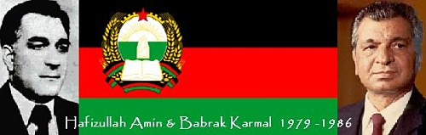
HAFIZULLAH AMIN (1929-1979)

Slide 16
HAFIZULLAH AMIN (1979 AD)
Hafizullah Amin and Babrak Karmal were both members of Khalq and Parcham cmmunist factions and ruled the country for seven years.
(1929-1979) Hafizullah Amin was born on August 1, 1929 in Pashtun family in Paghman district of Kabul. Amin studied at Kabul University then he left to the United States for graduate studies at Columbia University. When he returned to Afghanistan, he joined the People's Democratic Party of Afghanistan ‘PDPA’ and then he become the deputy prime minister of Nur Mohamad Taraki. However, Taraki and Amin worked together as a president and deputy prime minister for a few months but it didn’t work well. In September of 1979 Amin assassinated President Taraki and took control of the government and announced himself as the second communist President. Hoever, his presidency didn’t continue long either and on December of the same year (1979), a Russian KGB member assassinated him in his palace and Babrak Karmal became the President.
However, Hafizullah Amin and Babrak Karmal were both from two opposition factions, the Soviet Union have has installed Karmal in order to achieve its goals.

Slide 17
BABRAK KARMAL (1929-1996)

Slide 18
BABRAK KARMAL (1979-1986 AD)
(1929-1996) Babrak Karmal was born on 6 January 1929 in a wealthy family in east part of Kabul. He completed his education at Kabul University and while he was at University, he gained reputation as an activist in the student union. Later he involved in political activities while he was a student, and as a result, he imprisoned for five years. After his release, he joined the PDPA communist party in 1965 and then he was appointed a secretary of the party. Karmal also served in quasi-democratic National Assembly of Afghanistan which was during the constitutional monarchy of King Zahir Shah from 1965-1973.
Babrak Karmal became the third communist President of Afghanistan after the assassination of Afizullah Amin in 1979 and continued untill 1986. In May 1986 Babrak was replaced by Dr. Najibullah and he left to Moscow where he died in 1996. Afghanistan flag during the second communist regime was changed back to horizontal three color stripes with a different emblem on the top right side.

Slide 19
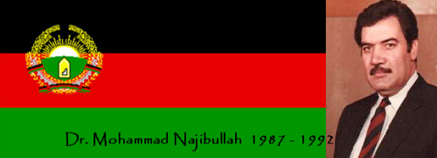
Dr. MOHAMMAD NAJIBULLAH (1947-1996)

Slide 20
Dr. MUHAMMAD NAJIBULLAH (1987-1992 AD)
(1947 – 1996) Dr. Mohammad Najibullah known as Dr Najibullah was born in August 1947 in a Pashtun family in Kabul, but his family was originally from Paktia province of Afghanistan. Dr. Najib was enrolled at Habibia High School in Kabul and then attended Kabul University where he achieved his degree as a medicine doctor in 1975. Najib Joined the PDPA and then he became secretary general of the PDPA after the resignation of Babrak Karmal. In 1986 Dr. Najibullah was elected as a president of Afghanistan and a new constitution was adopted and later the name of the country was reverted to the Republic of Afghanistan.
Dr. Najib stabilized his political position enough to begin matching Moscow’s moves toward withdrawal which in result the Soviet invasion of Afghanistan was ended on July 20, 1987 with the withdrawal of Soviet troops. After the withdrawal, the Soviet support reached in a value of $3 billion in 1990 and Kabul had achieved a stalemate which exposed the Mujahideen’s weakness in political and military wise, and Najibullah's government survived for another two years.
In March of 1990, Dr Najibullah’s government successfully stood against a Khalqi coup which it was headed by the Defense Minister ‘Shahnawaz Tanai’. When the coup failed Mr. Tanai fled to Pakistan. Afterward the government of Najibullah got weaker and then the regime collapsed, as Kabul was short in fuel and food. Shortly on March 18 of 1992, president Najibullah announced his willingness to resign in order to find ways for a neutral interim government.

